Slide 1
Sephora Research Analytics Report

Slide 2
Content
Research Topic
Sentiment Analysis
Positioning Analysis
Segmentation Analysis
Predictive Analysis
Recommendation
Limitation & Improvements

Slide 3
Research Topic

Slide 4
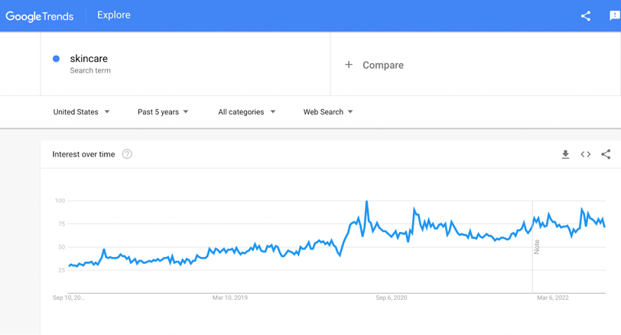
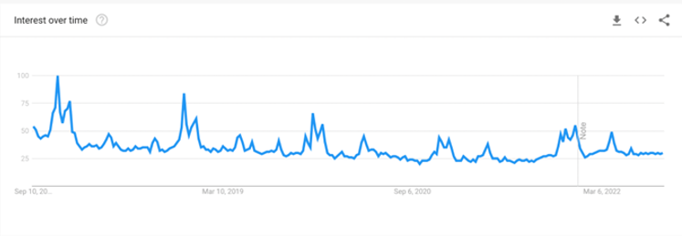
Google Trend Analysis
The web search volume of SKINCARE has been continuous increasing
The web search volume of SEPHORA shows a slightly deteriorating trend​
Sephora has the probability of losing customers and opportunities
Increasing SKINCARE Web Search ​
Decreasing SEPHORA Web Search

Slide 5
Opportunities and Challenges
Opportunities
The continuous growth of the whole cosmetics market​
The booming of the E-commerce platform​
Challenges
Quality control issue​
Websites are not accessible

Slide 6
With Industry Increasing | Facing Opportunities & Challenges
How can Sephora Compete
with Other Cosmetic Selling Channels?

Slide 7
Sentiment Analysis

Slide 8
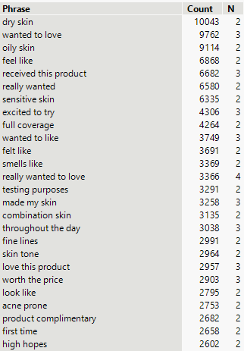
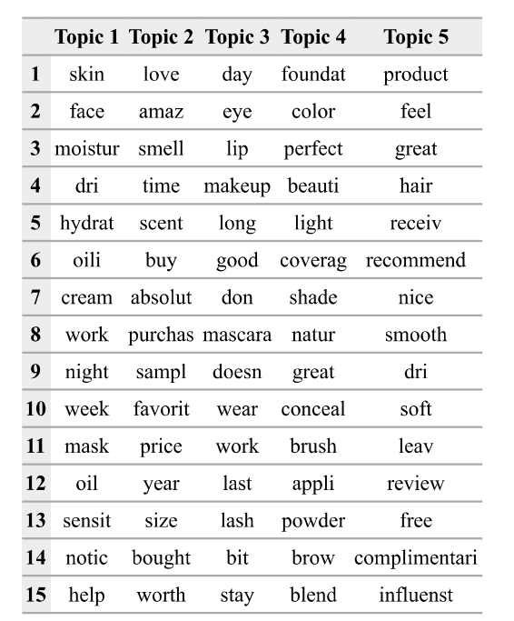

Sephora Review - Positive
Various Products & Good Shopping Experience
Skincare, hair, and Cosmetic Products
Hundreds of different Brands
Free samples and try-on
Product with High Quality
Authentic seller for all brands
Good Return Policy if not satisfied

Slide 9
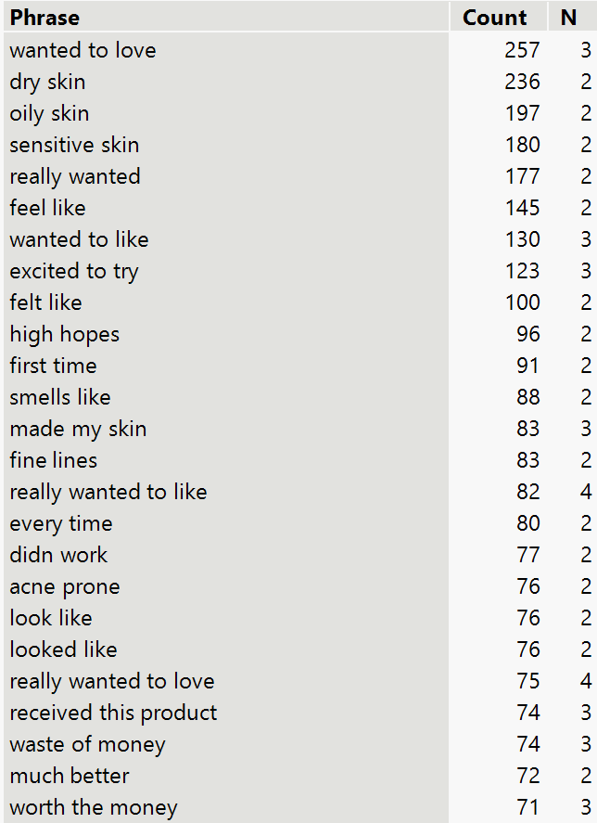
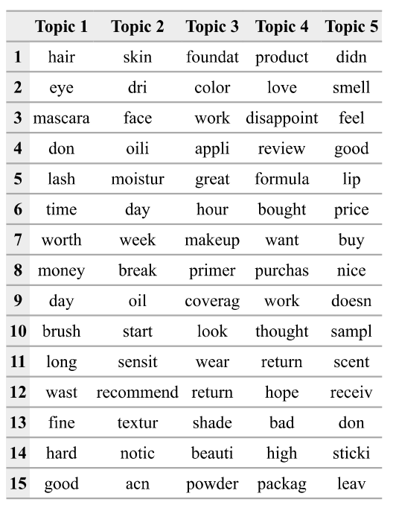
Sephora Review - Negative
Low Purchase Speed
Unable to find an associate to help with their shopping
Cannot find what they want quickly in store
Long line waiting for checking out
Price Issue
Some products are not cost-efficiency
Average price is too high
Some products do not have obvious effects.

Slide 10
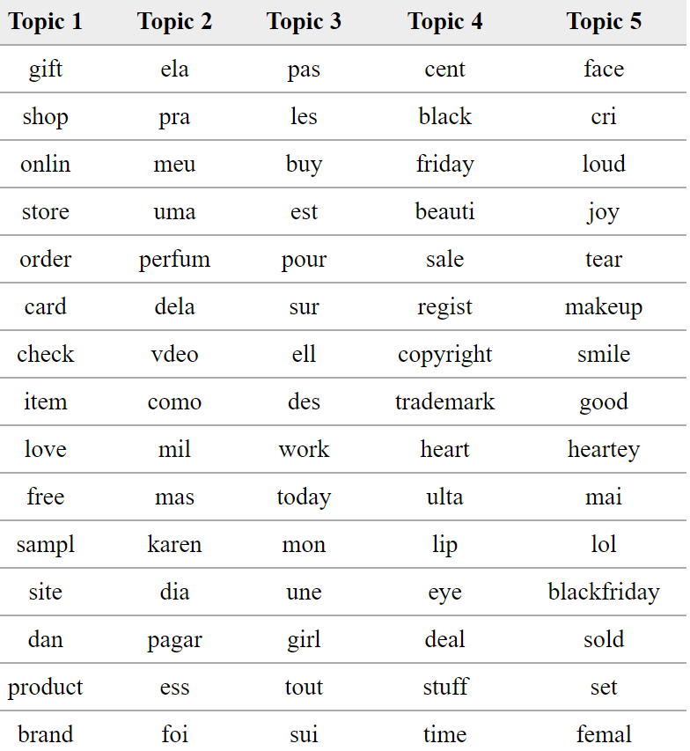
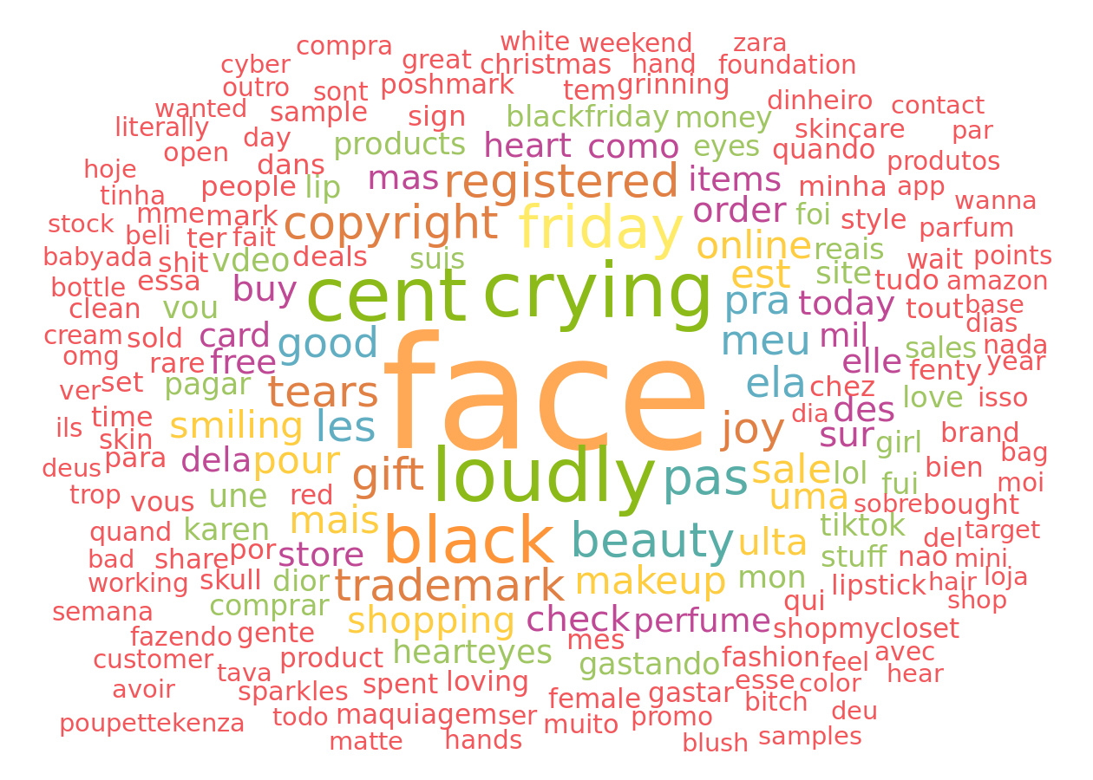
Twitter Reviews Analysis
Good Reputation on Media
Promotion is the Key
About 70% posts are Positive
People show enthusiasm to shopping
Black Friday attracts lots of customers
Promotion is one of the most important things on the social media

Slide 11
Positioning Analysis

Slide 12
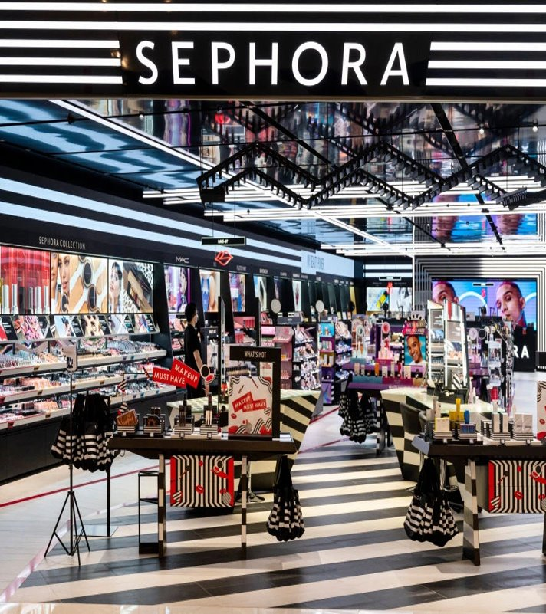
Positioning Statement​
For cosmetic customers ​
Who have the pursuit of beauty and want quality and extreme purchase experience. ​
Sephora is a leading cosmetic product collection store​
That offers prestige products in every category, unbiased service from beauty experts and an interactive shopping environment​
Because Sephora is providing increasing assortment of products from carefully curated brands, featuring emerging favorites, trusted classics, and Sephora’s own line, Sephora Collection​

Slide 13
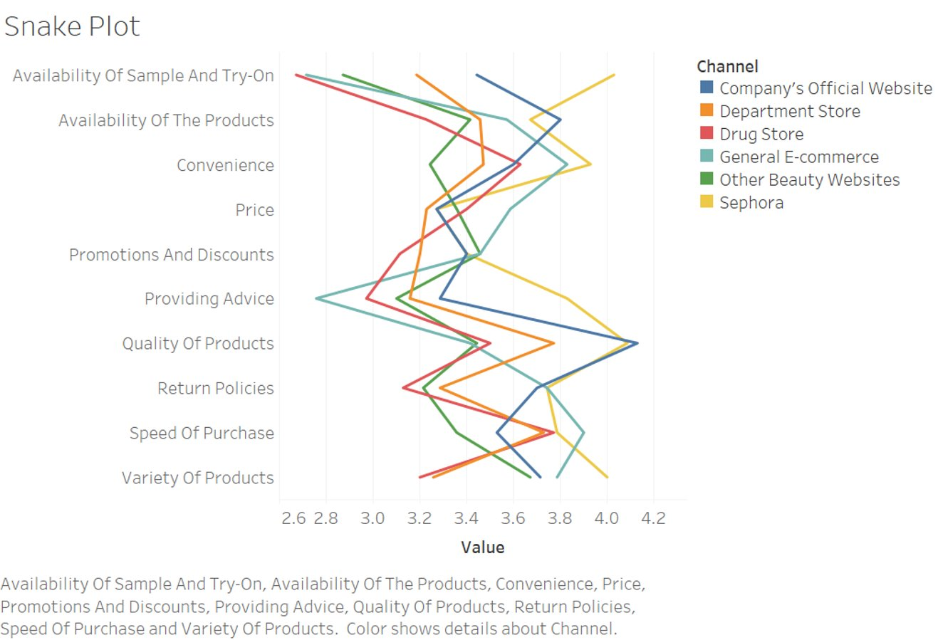
Advantages of Sephora​
Availability of Samples and Try-on​
Convenience ​
Quality of Products​
Return Policies​
Variety of Products

Slide 14
Disadvantages of Sephora​
Price​
Availability of products compared to company’s official website​
Speed of purchase compared to general e-commerce channel

Slide 15
Segmentation Analysis

Slide 16
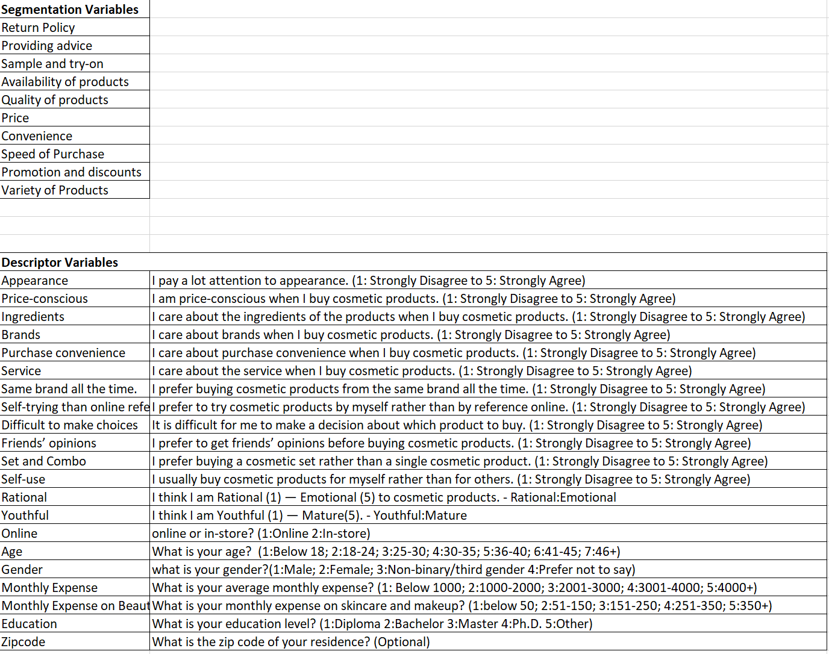
Variables
Segmentation Variables
Description Variables

Slide 17
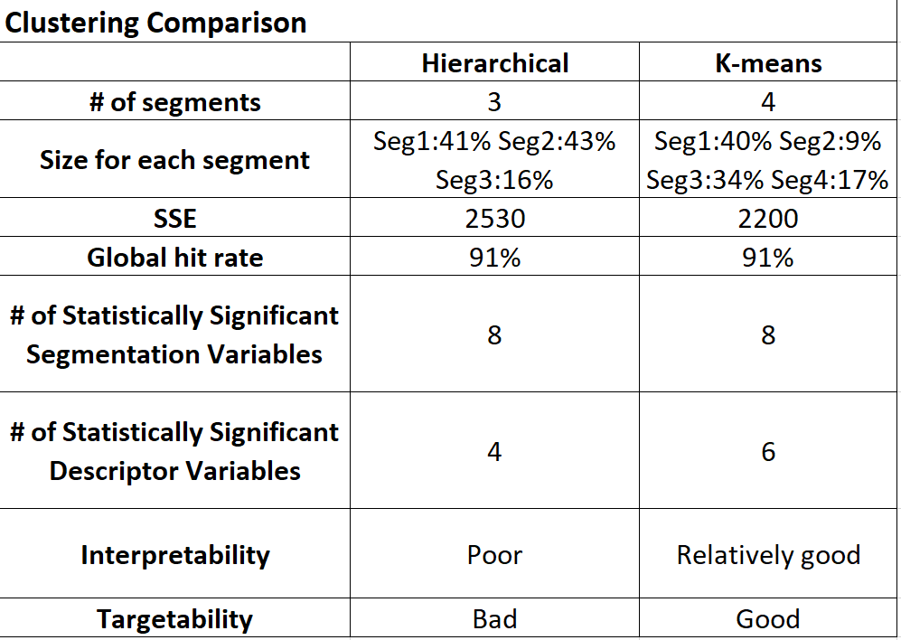
Clustering Comparison
We decided to go with the K-means Clustering for better statistical significance and managerial usefulness

Slide 18
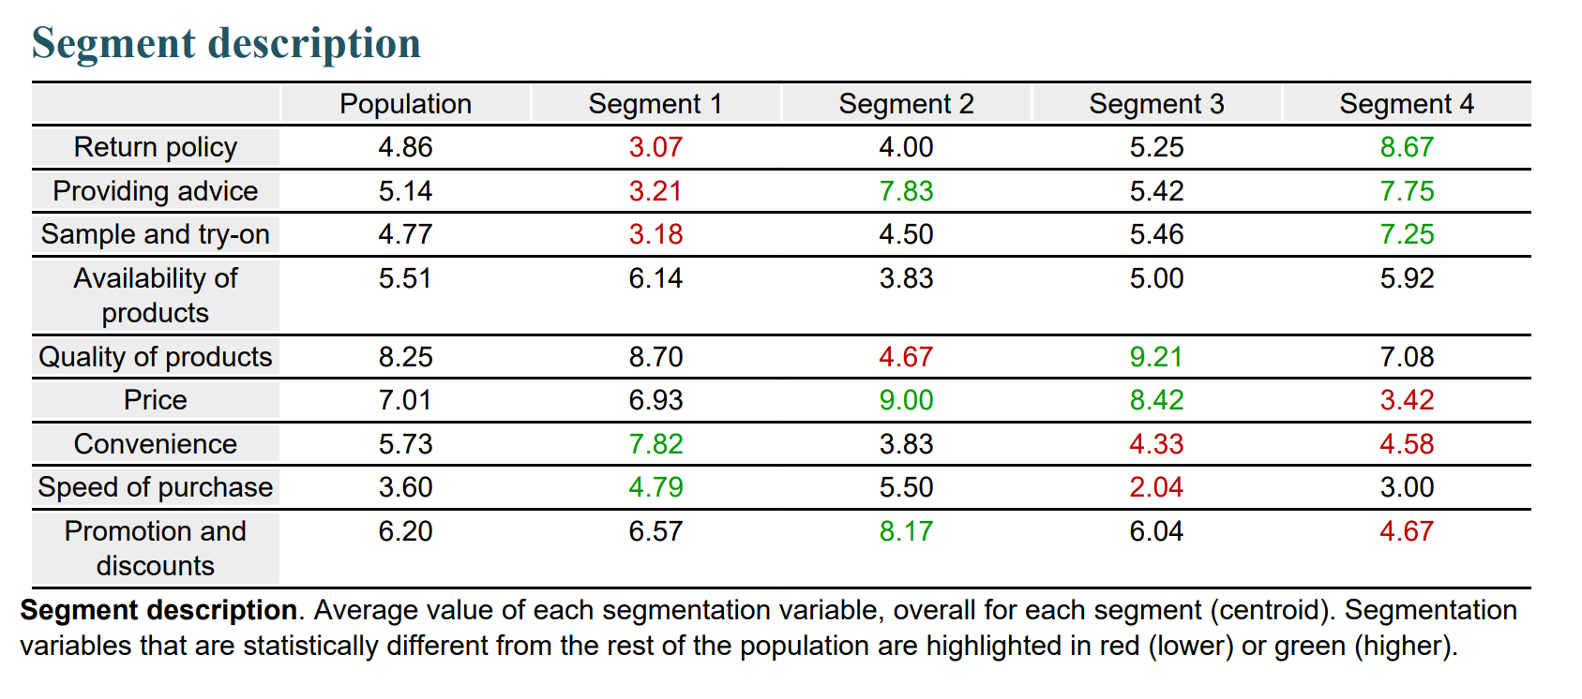
Segmentation Analysis
Segment 1: Convenience seekers
Segment 3: Value for Quality Seekers
Segment 2: Value for Service Seekers
Segment 4: Service Seekers

Slide 19
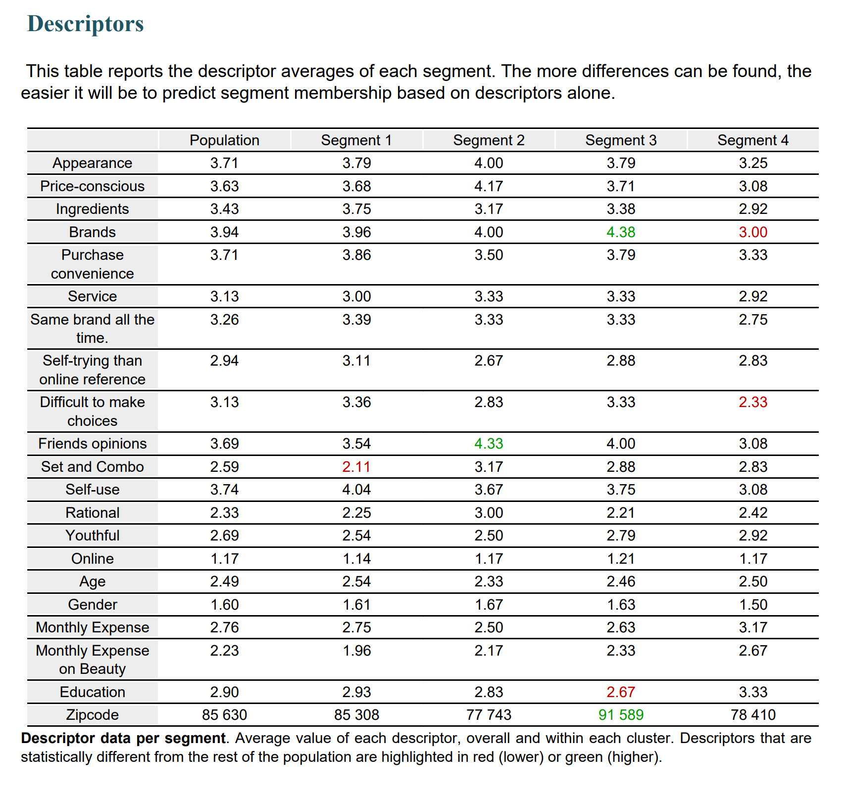
Segmentation Descriptors
Convenience seekers
Value for Service Seekers
Love fast and easy shopping
Single item > Set or combo
No interest in services
Rely on other’s advice
Not big fan of product quality
Price and promotion driving
Value for Quality Seekers
Service Seekers
Quality goods with lower price
Lower Education level
Rely on brand image
Patient to get good deals
Seek good services & experience
Open-minded about brand
Understand what they need

Slide 20
Segmentation Descriptors

Slide 21

Persona
Convenience Seekers
Value for Service Seekers
Love fast and easy shopping
Single item > Set or combo
No interest in services
Rely on other’s advice
Not big fan of product quality
Price and promotion driving
Value for Quality Seekers
Service Seekers
Quality goods with lower price
Lower Education level
Rely on brand image
Patient to get good deals
Seek good services & experience
Open-minded about brand
Understand what they need

Slide 22
Predictive Analysis

Slide 23
Predictive Results – Prediction Models
INDEPENDENT VARIABLES | Equation | interpretation
Purchase (21.53%, 0.0086) | Ln(odds) = 0.9815 - 0.4213*Monthly Expense + 1.4786*Gender - 0.8654*Age + 0.4342*try By Myself 0.4043*Cosmetic Set + 0.5068*Emotional | A younger female who is more emotional, has fewer monthly expenses, prefers to try the product by herself, and less likes cosmetic sets is more likely to purchase in Sephora.
Satisfaction (23.34%, 0.0522) | Satisfaction = 5.6636 - 0.1337*Ingredients - 0.2232*Service + 0.1637*Same Brand + 0.1791*Try by Myself - 0.2335*Monthly Expenses - 0.2829*Education | A customer who pays less attention to ingredients, pays less attention to the service, prefers to buy products from the same brand, prefers to try by themselves, has fewer monthly expenses, and has a lower education level tends to have a higher satisfaction level.
Recommendation (49.56%, 0.0001) | Recommendation = -1.1393 + 0.8822*Appearance + 0.4719*Price Conscious + 0.3376*Same Brand + 1.0783*In Store + 0.6055*Age | A customer who is more mature, pays more attention to appearance, is more price sensitive, prefers to buy products from the same brand, and prefers to buy products in-store tends to recommend Sephora to others.

Slide 24
Predictive Results – Prediction Models
INDEPENDENT VARIABLES | Equation | interpretation
Click Rate (39.2%, 0.0009) | Click Rate = 5.0069 - 0.1726*Ingredients + 0.2622* Purchase Convenience - 0.2890*Service - 0.4200*For Myself - 0.3459*Emotional + 1.0161*Gender - 0.7968*Education | A female who is less emotional, pays less attention to ingredients, pays more attention to purchase convenience, pays less attention to service, prefers to buy for herself, and has a lower education level tends to show higher click rate when she is exposed to advertising.
Transaction rate (53.67%, 0.0001) | Transaction Rate = 0.6341 - 0.2362*Click Rate - 0.2917*In-Store + 0.1145*Mature + 0.0785*Brands - 0.0816*Indecisive + 0.1424*Friends’ Opinion - 0.0828*Cosmetic Set | A person who is more decisive in purchasing, has a lower CTR, prefers to purchase the products online, pays more attention to the brands, pays more attention to friends' opinions, and less likes cosmetic sets tends to show a higher transaction rate.

Slide 25
Predictive Results – Logit Targeting
The biggest lift, which is 15%, happens when 60% of the market is advertised
Percent Lift
% of Market Contacted | Logit Targeting | Random Targeting | Lift
0% | 0.00% | 0.00% | 0.00%
10% | 9.62% | 10.00% | -0.38%
20% | 23.08% | 20.00% | 3.08%
30% | 36.54% | 30.00% | 6.54%
40% | 50.00% | 40.00% | 10.00%
50% | 63.46% | 50.00% | 13.46%
60% | 75.00% | 60.00% | 15.00%
70% | 80.77% | 70.00% | 10.77%
80% | 90.38% | 80.00% | 10.38%
90% | 96.15% | 90.00% | 6.15%
100% | 100.00% | 100.00% | 0.00%
15%

Slide 26
Predictive Results – Segments Performance
Segment 2 is the most valuable segment with the highest satisfaction, recommendation tendency, and transaction rate
Segment 4 has the highest click rate
Average | Satisfaction | Recommendation | CR | TR
Segment 1 | 3.0357 | 5.9286 | 106.31% | 59.79%
Segment 2 | 4.5000 | 7.8333 | 132.80% | 78.96%
Segment 3 | 2.4583 | 4.7500 | 143.74% | 52.94%
Segment 4 | 3.5833 | 5.8333 | 179.60% | 51.36%

Slide 27
Recommendation

Slide 28
Positioning
01
Provide Extreme Experience
02
Optimize Inventory Management
Provide skin type test both online and offline
Provide skin and lips color test and shape test
Arrange inventory leveraging prediction models
Improve inventory distribution strategy and turnover efficiency
03
Improve shopping efficiency
For offline stores, install iPads in every store for quick searches on product information including price, trend, reviews, colors and etc.

Slide 29
Segmentation
01
Convenience Seekers
02
Value for Service Seekers
Provide subscription plans for essential products
Emphasize shipping speed and shopping convenience
Send out more coupons and promotional information
Emphasize Sephora’s beauty consulting services
04
Service Seekers
03
Value for Quality Seekers
Send out more coupons and promotional information
Emphasize products’ quality and function
Develop them in membership and rewards program
Engage them with product and service information

Slide 30
Positioning
01
For Targeting
Young females, more emotional, fewer monthly expenses, prefer to try the product by themselves, less like cosmetic set
Segment 2: higher satisfaction, higher recommendations rate, higher transaction rate. Segment 4: higher click rate.
Logit Targeting: maximum 15% lift
02
For promotion
Promoting people: lower click rate, prefer online shopping, more decisive, less like cosmetic sets

Slide 31
Limitation & Improvement

Slide 32
Limitation 1:
Number of Responses
Limitation 2:
Variety of Samples
Limitation 3:
Other Information
Only collected 76 responses, which limited significance of multiple studies
Most responses are from USC students, causing strong data bias
Lack of information such as cost per person, profit per person, purchase recency
Collect more responses
Send surveys to various people groups
Further investigation
Add questions in survey

Slide 33
Thank You for Listening!

Slide 34
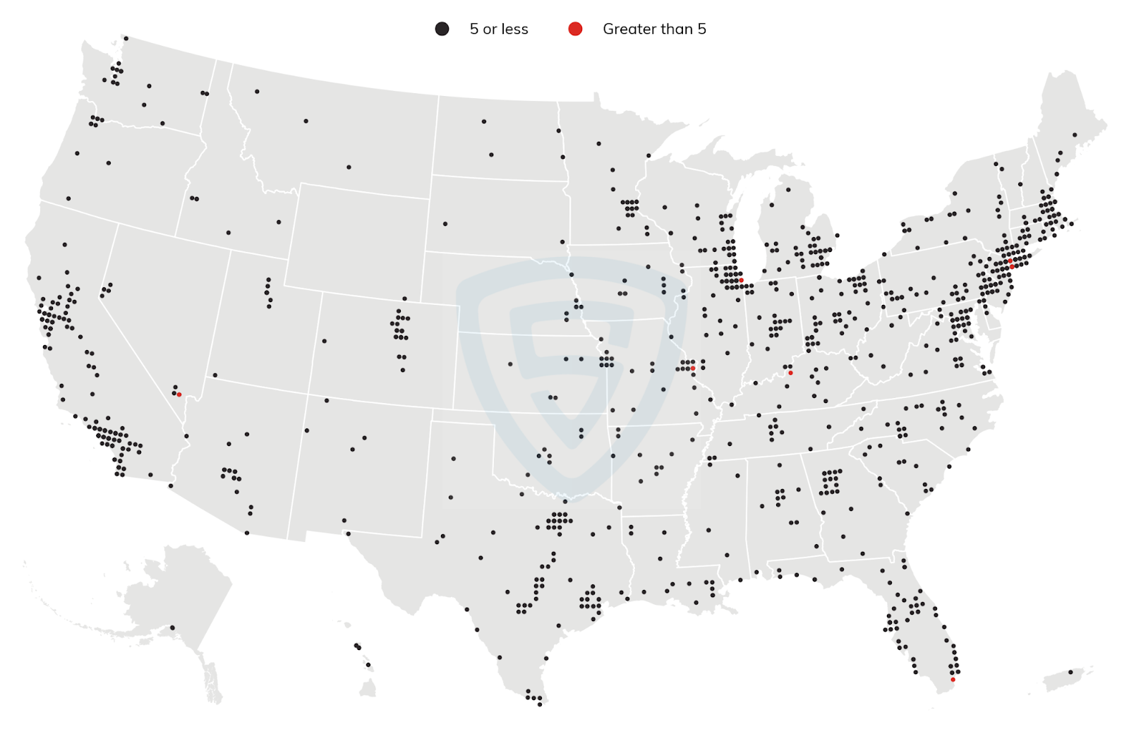
Major segments
26.21% Comfortable Empty Nesters
+ 17.91% In Style
+ 17.36% Parks and Rec
Profile: 26.21% Comfortable Empty Nesters
Households: 3,024,200
AvgHousehold Size: 2.52
Median Age: 48.0
Median Household Income: $75,000
Appendix: Geotargeting Analysis
Major segments
99.34% Laptops and Lattes
+ 0.66% Metro Renters
Profile: 99.34% Laptops and Lattes
Households: 1,307,500
Average Household Size: 1.87
Median Age: 37.4
Median Household Income: $112,200
Major segments
41.73% Trendsetters
+ 22.83% NeWest Residents
+ 15.59% High Rise Renters
Profile: 41.73% Trendsetters
Households: 1,319,400
Avg Household Size: 2.12
Median Age: 36.3
Median Household Income: $63,100

